Slide 1

Data Structures & Algorithms
Week-09

Slide 2
Week-09 Agenda
Graph Algorithms
  Shortest Path Algorithms (Dijkstra’s, Bellman-Ford)
  Minimum Spanning Trees (Prim’s, Kruskal’s)

Slide 3
Dijkstra’s Algorithm
Dijkstra's algorithm is a solution to graph theory's single-source shortest path problem.
Works on both directed and undirected graphs. However, all edges must have nonnegative weights.
Input: Weighted graph G={E,V} and source vertex v∈V, such that all edge weights are nonnegative
Output: Lengths of shortest paths (or the shortest paths themselves) from a given source vertex v∈V to all other vertices

Slide 4
Dijkstra’s Algorithm
Purpose: Find the shortest path from a single source to all other vertices in a weighted graph.
Key Feature: Assumes all edge weights are non-negative.
Process: Uses a priority queue to select the vertex with the smallest tentative distance iteratively and updates the distances to its neighbors.

Slide 5
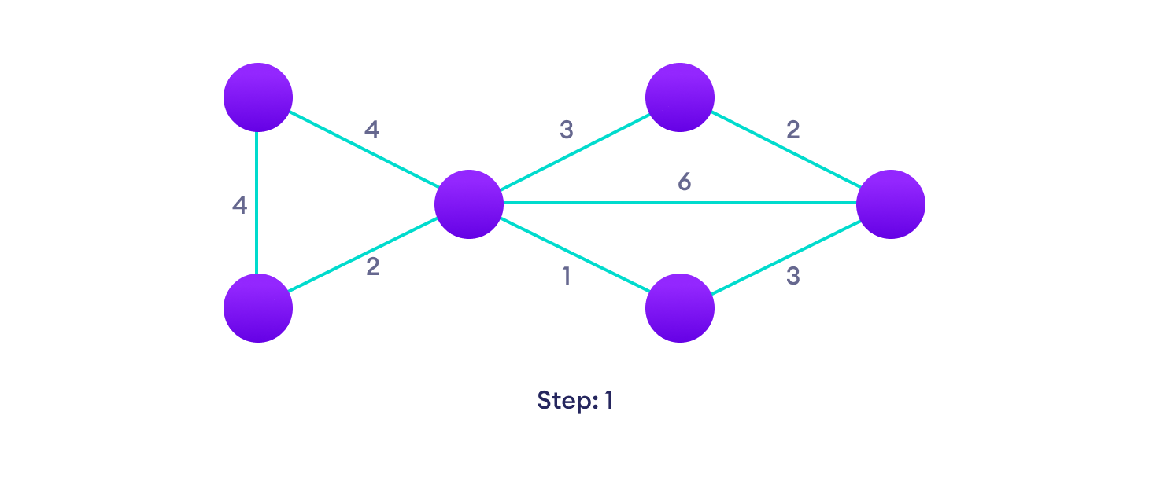
Dijkstra’s Algorithm
Start with a weighted graph

Slide 6
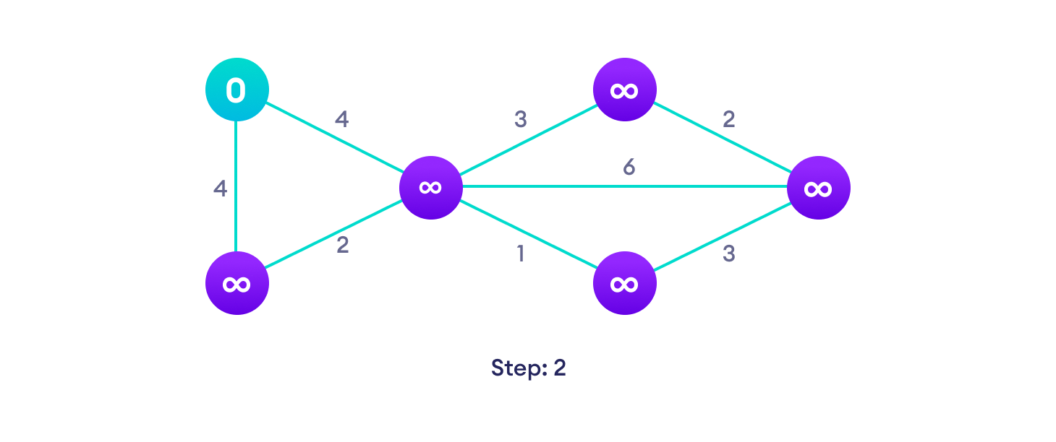
Dijkstra’s Algorithm
Choose a starting vertex and assign infinity path values to all other devices

Slide 7
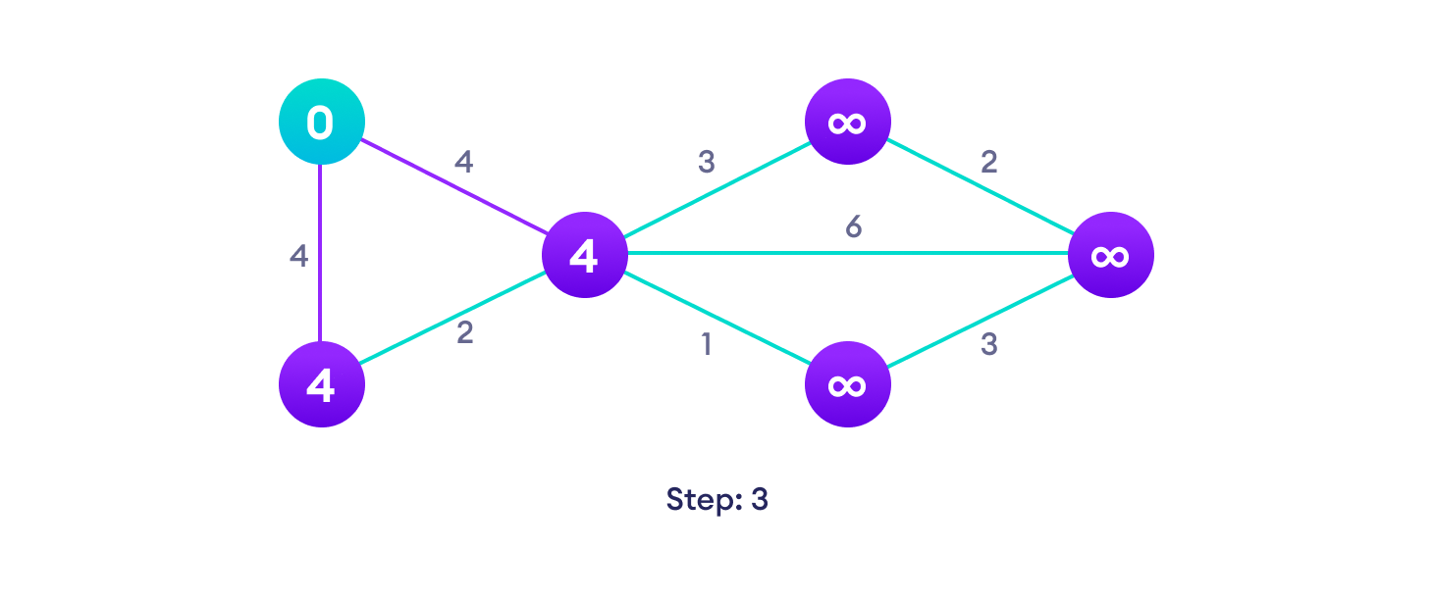
Dijkstra’s Algorithm
Go to each vertex and update its path length

Slide 8
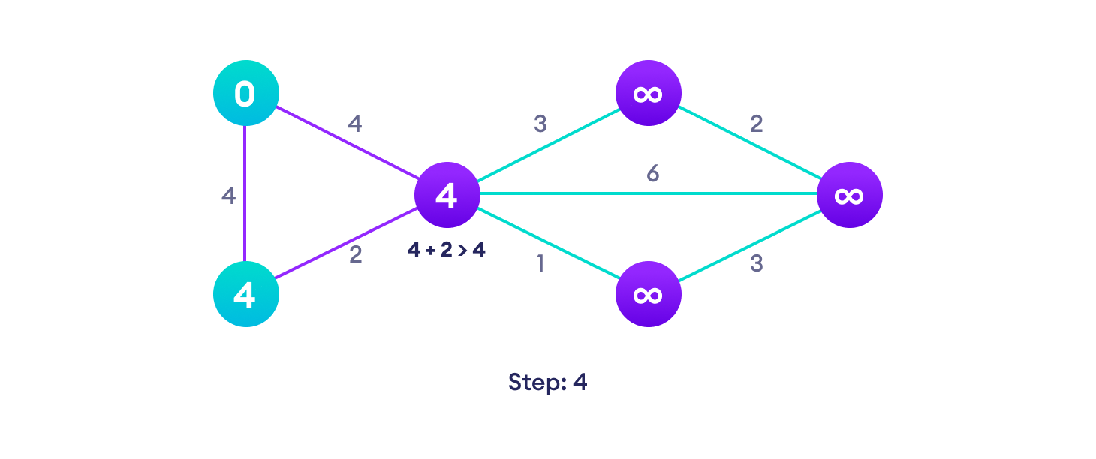
Dijkstra’s Algorithm
If the path length of the adjacent vertex is lesser than new path length, don't update it

Slide 9
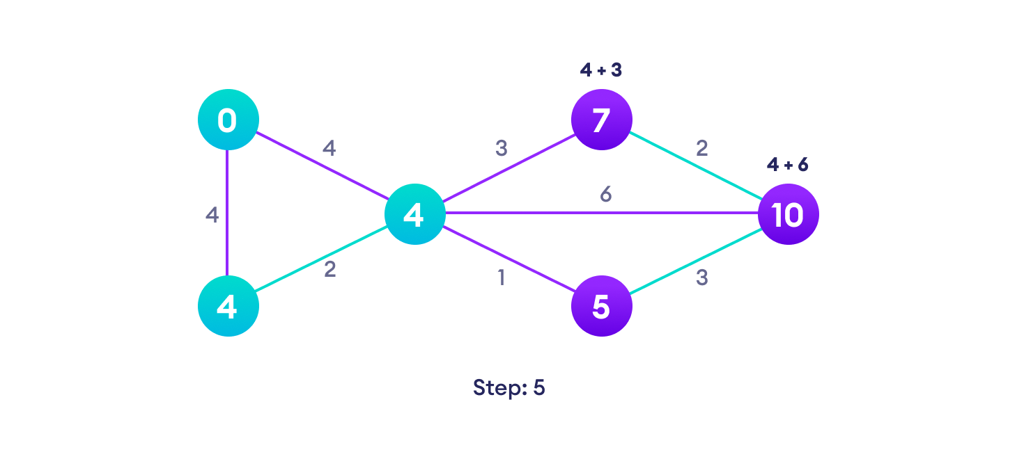
Dijkstra’s Algorithm
Avoid updating path lengths of already visited vertices

Slide 10
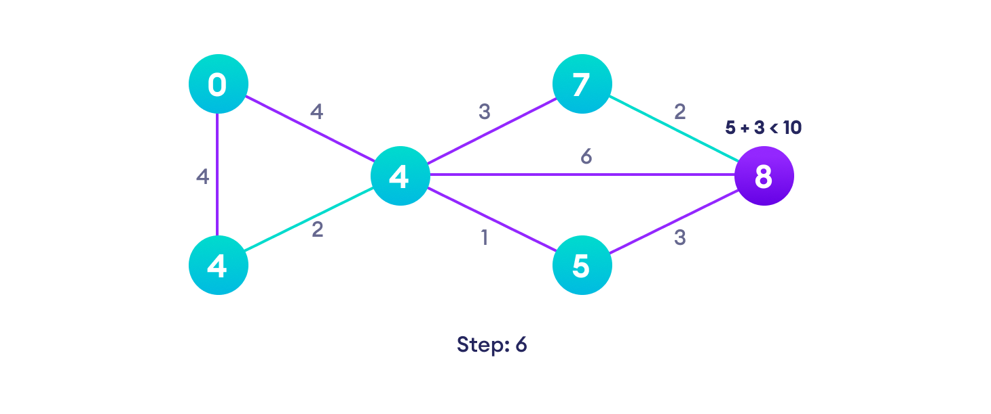
Dijkstra’s Algorithm
After each iteration, we pick the unvisited vertex with the least path length. So we choose 5 before 7

Slide 11
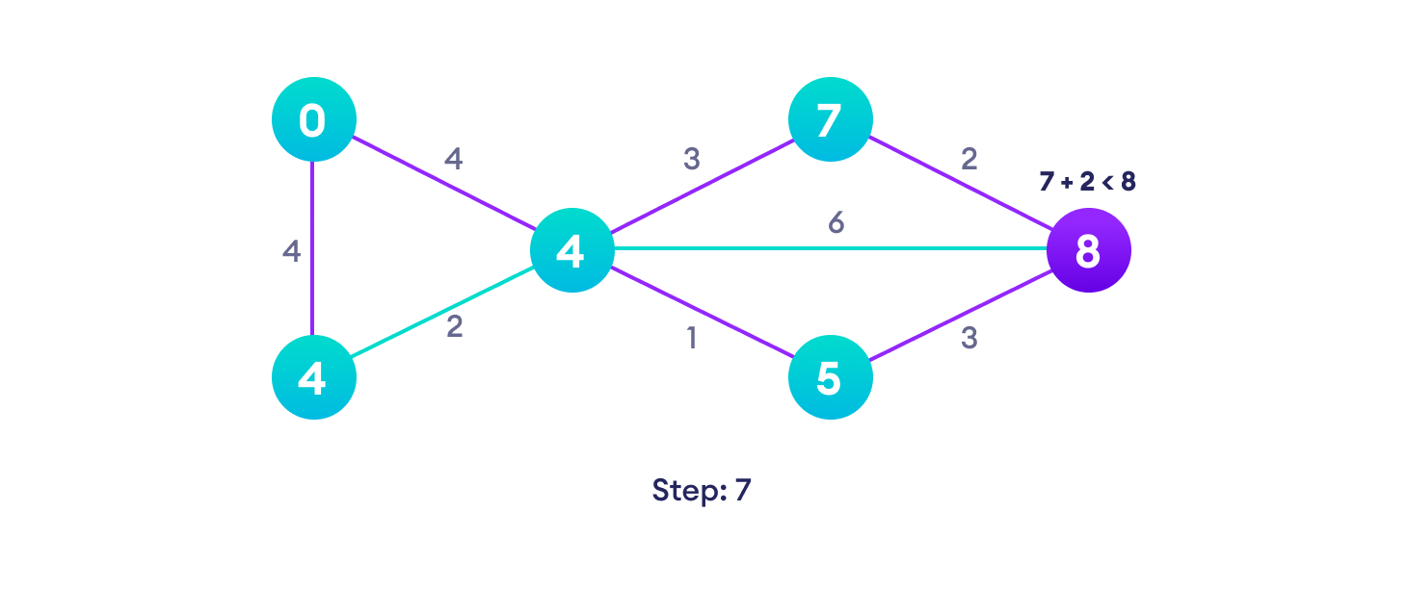
Dijkstra’s Algorithm
Notice how the rightmost vertex has its path length updated twice

Slide 12
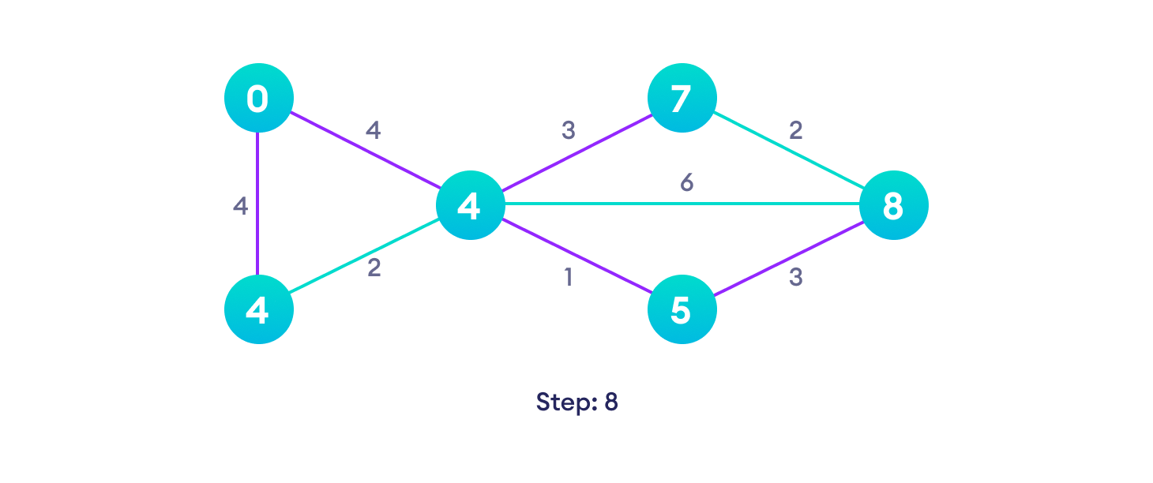
Dijkstra’s Algorithm
Repeat until all the vertices have been visited

Slide 13
Bellman-Ford Algorithm
Bellman-Ford Algorithm
Purpose: Computes shortest paths from a single source to all other vertices, even if the graph contains negative-weight edges.
Key Feature: Can detect negative weight cycles.
Process: Relaxes all edges repeatedly over (V−1) iterations (where V is the number of vertices).

Slide 14
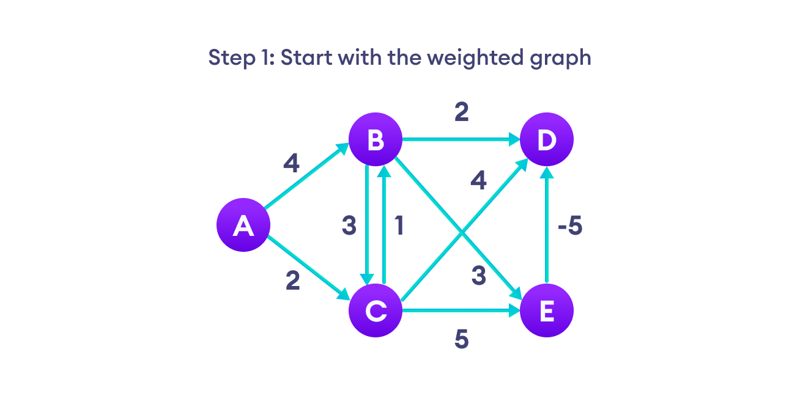
Bellman-Ford Algorithm

Slide 15
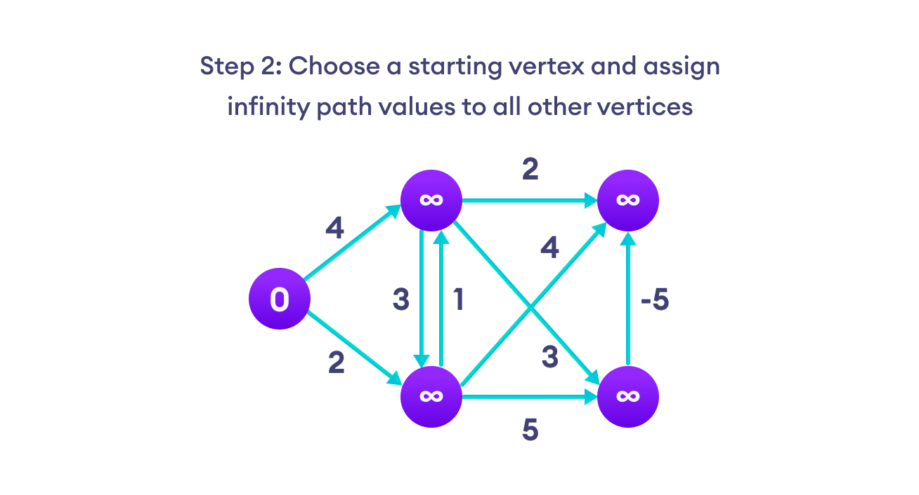
Bellman-Ford Algorithm

Slide 16

Bellman-Ford Algorithm

Slide 17
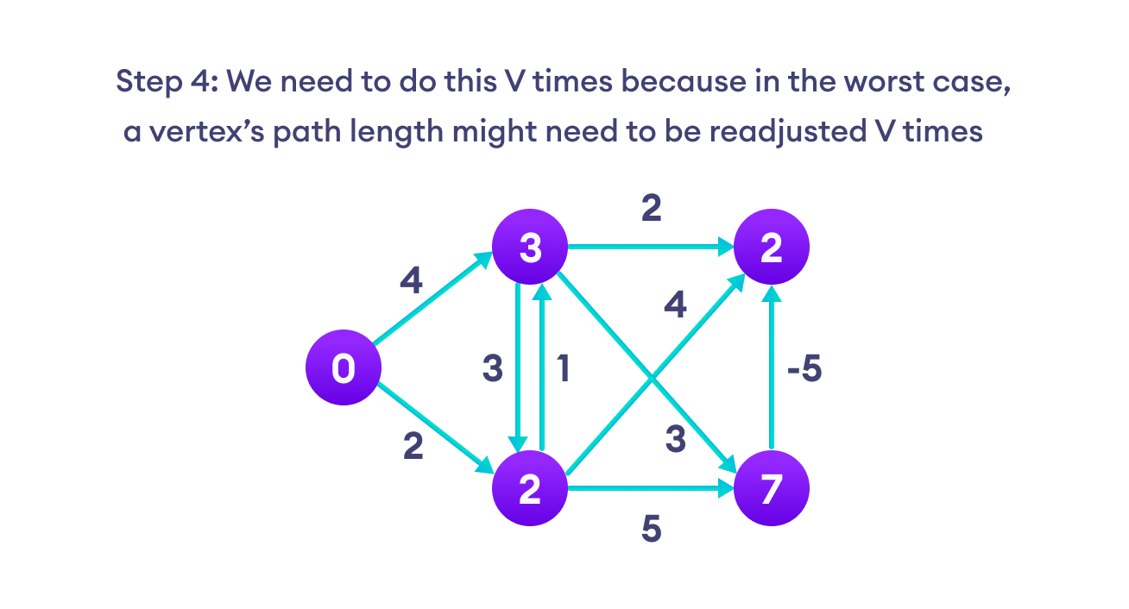
Bellman-Ford Algorithm

Slide 18
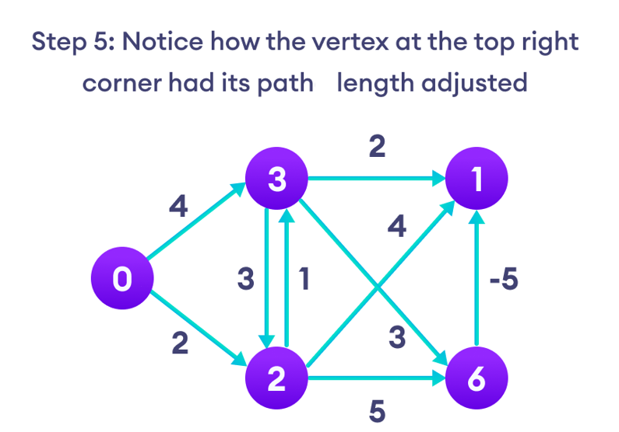
Bellman-Ford Algorithm

Slide 19
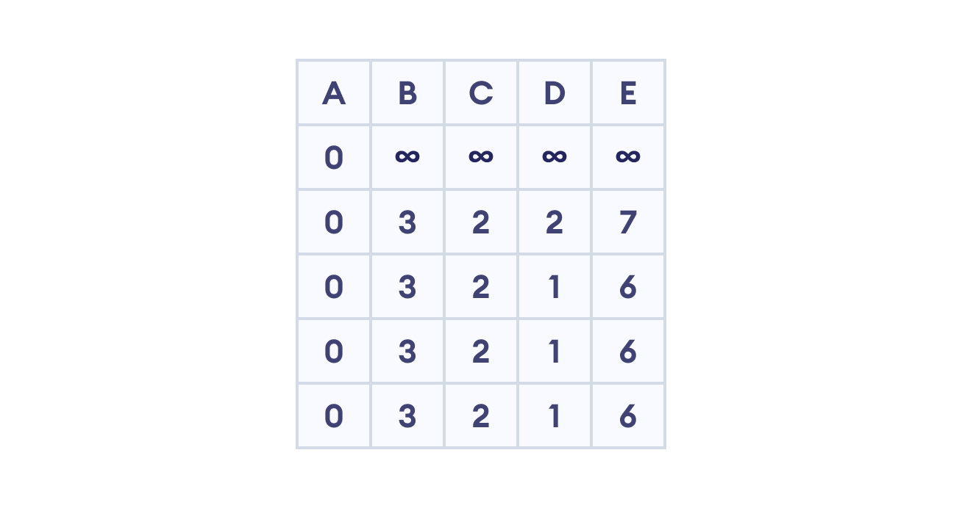
Bellman-Ford Algorithm

Slide 20
Kruskal’s Algorithm
How Kruskal's algorithm works
We start from the edges with the lowest weight and keep adding edges until we reach our goal.
The steps for implementing Kruskal's algorithm are as follows:
Sort all the edges from low weight to high
Take the edge with the lowest weight and add it to the spanning tree. If adding the edge created a cycle, then reject this edge.
Keep adding edges until we reach all vertices.

Slide 21

Kruskal’s Algorithm
Start with a weighted graph

Slide 22

Kruskal’s Algorithm
Choose the edge with the least weight, if there are more than 1, choose anyone

Slide 23

Kruskal’s Algorithm
Choose the next shortest edge and add it

Slide 24
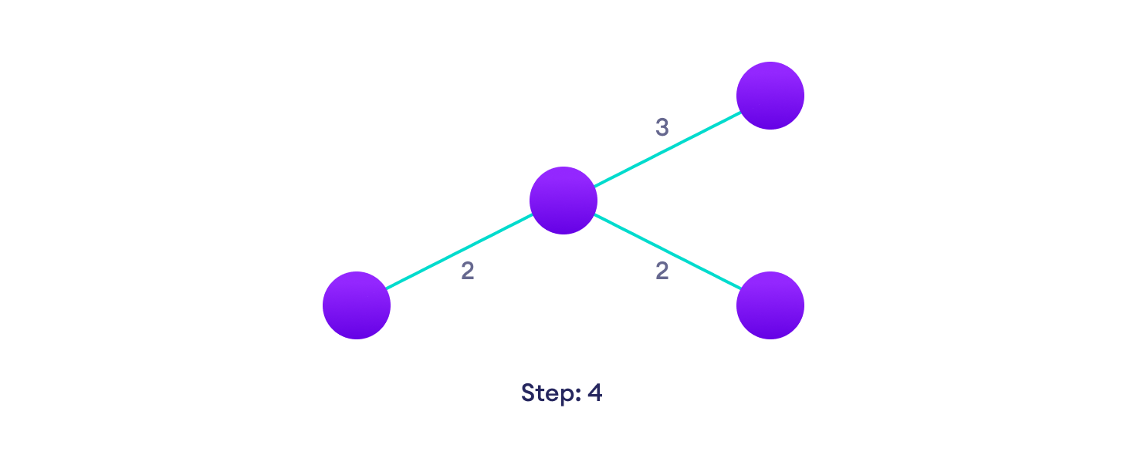
Kruskal’s Algorithm
Choose the next shortest edge that doesn't create a cycle and add it

Slide 25
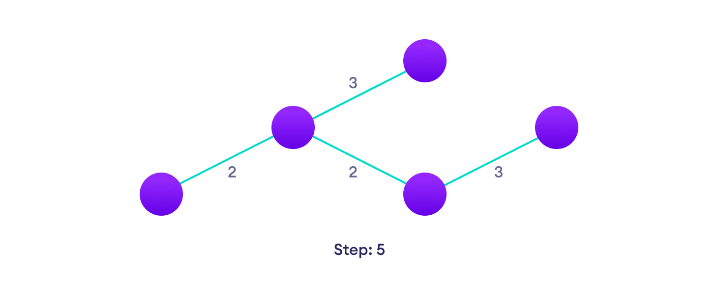
Kruskal’s Algorithm
Choose the next shortest edge that doesn't create a cycle and add it

Slide 26
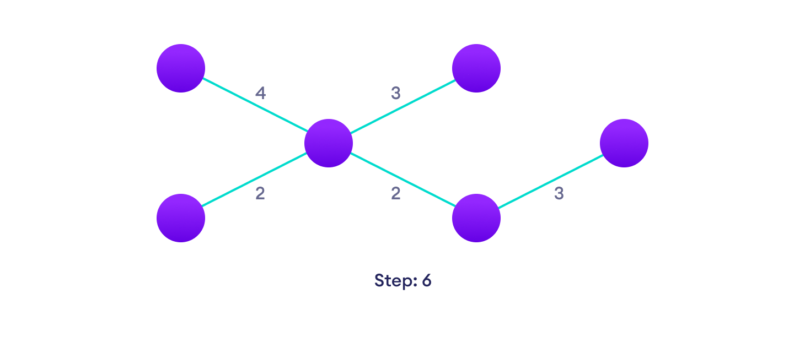
Kruskal’s Algorithm
Repeat until you have a spanning tree

Slide 27
Prim’s Algorithm
Prim's algorithm is a minimum spanning tree algorithm that takes a graph as input and finds the subset of the edges of that graph which:
  form a tree that includes every vertex
  has the minimum sum of weights among all the trees that can be formed from the graph

Slide 28
Prim’s Algorithm
The steps for implementing Prim's algorithm are as follows:
  Initialize the minimum spanning tree with a vertex chosen at random.
  Find all the edges that connect the tree to new vertices, find the minimum and add it to the tree
  Keep repeating step 2 until we get a minimum spanning tree

Slide 29
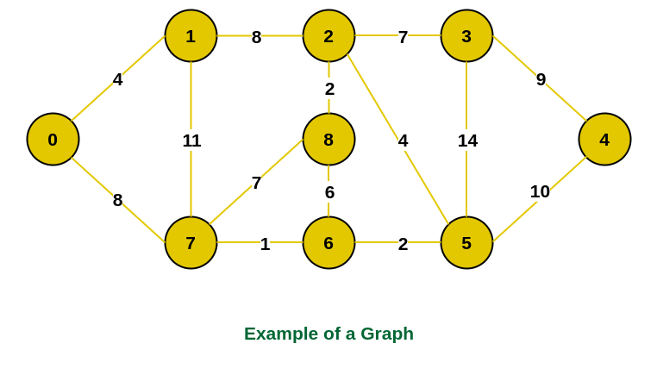
Prim’s Algorithm

Slide 30
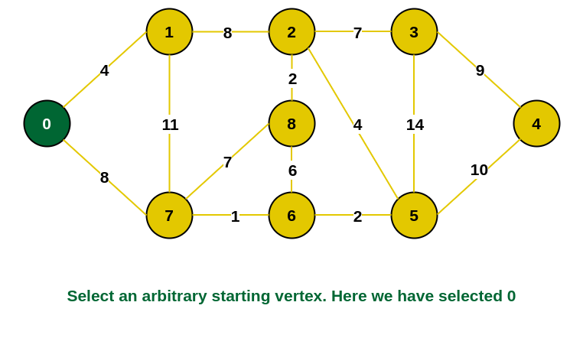
Prim’s Algorithm
Step 1: Firstly, we select an arbitrary vertex that acts as the starting vertex of the Minimum Spanning Tree. Here we have selected vertex 0 as the starting vertex.

Slide 31
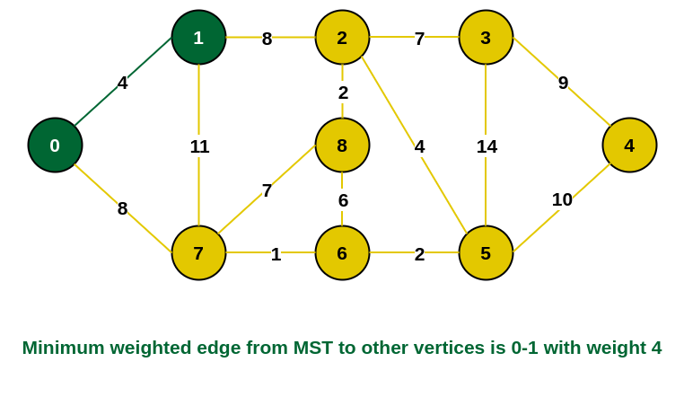
Prim’s Algorithm
Step 2: All the edges connecting the incomplete MST and other vertices are the edges {0, 1} and {0, 7}. Between these two the edge with minimum weight is {0, 1}. So include the edge and vertex 1 in the MST.

Slide 32
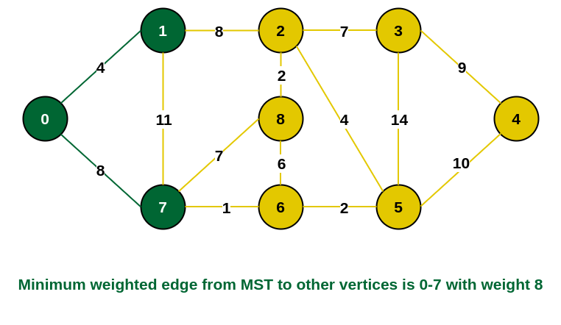
Prim’s Algorithm
Step 3: The edges connecting the incomplete MST to other vertices are {0, 7}, {1, 7} and {1, 2}. Among these edges the minimum weight is 8 which is of the edges {0, 7} and {1, 2}. Let us here include the edge {0, 7} and the vertex 7 in the MST. [We could have also included edge {1, 2} and vertex 2 in the MST].

Slide 33
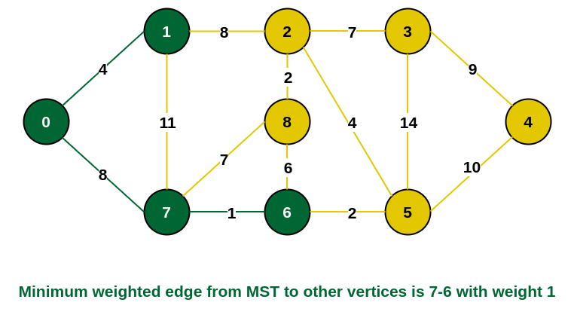
Prim’s Algorithm
Step 4: The edges that connect the incomplete MST with the fringe vertices are {1, 2}, {7, 6} and {7, 8}. Add the edge {7, 6} and the vertex 6 in the MST as it has the least weight (i.e., 1).

Slide 34
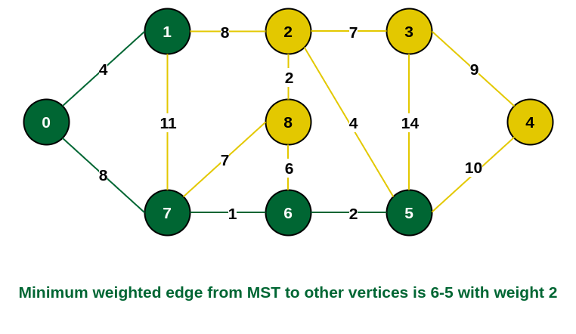
Prim’s Algorithm
Step 5: The connecting edges now are {7, 8}, {1, 2}, {6, 8} and {6, 5}. Include edge {6, 5} and vertex 5 in the MST as the edge has the minimum weight (i.e., 2) among them.

Slide 35
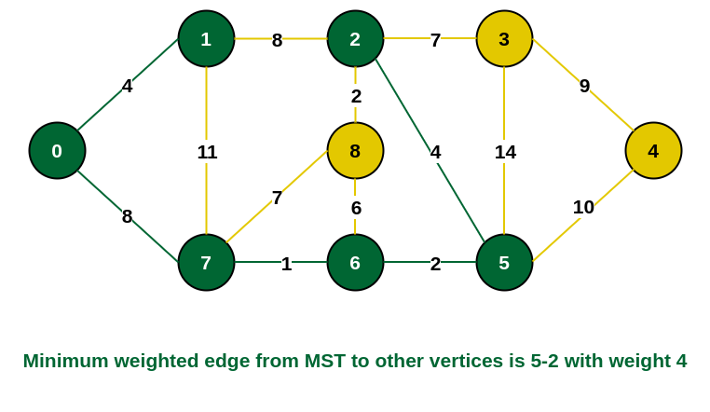
Prim’s Algorithm
Step 6: Among the current connecting edges, the edge {5, 2} has the minimum weight. So include that edge and the vertex 2 in the MST.

Slide 36
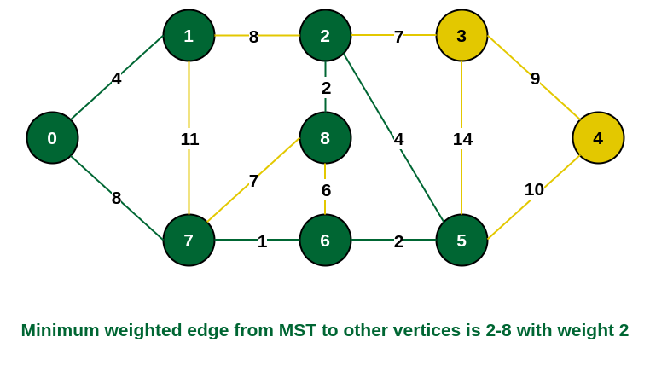
Prim’s Algorithm
Step 7: The connecting edges between the incomplete MST and the other edges are {2, 8}, {2, 3}, {5, 3} and {5, 4}. The edge with minimum weight is edge {2, 8} which has weight 2. So include this edge and the vertex 8 in the MST.

Slide 37
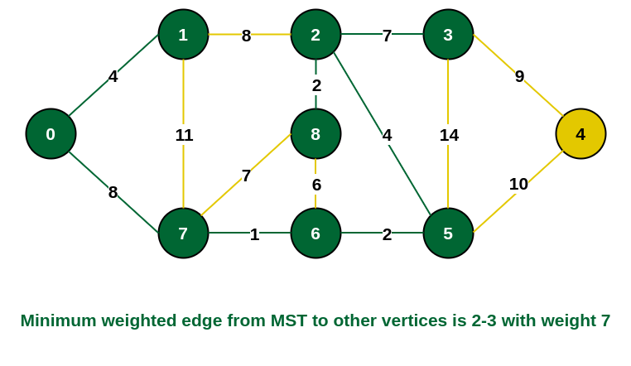
Prim’s Algorithm
Step 8: See here that the edges {7, 8} and {2, 3} both have same weight which are minimum. But 7 is already part of MST. So we will consider the edge {2, 3} and include that edge and vertex 3 in the MST.

Slide 38
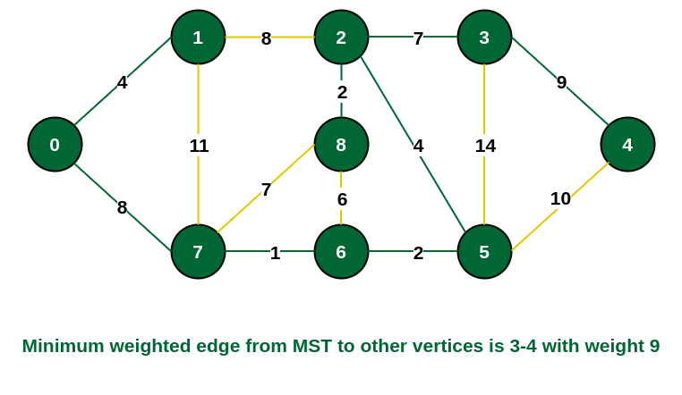
Prim’s Algorithm
Step 9: Only the vertex 4 remains to be included. The minimum weighted edge from the incomplete MST to 4 is {3, 4}.

Slide 39
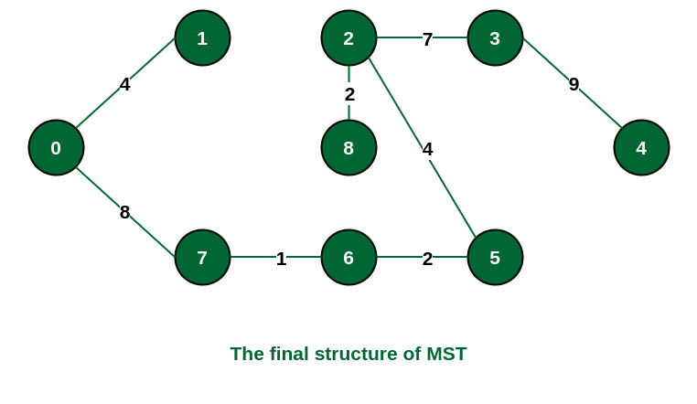
Prim’s Algorithm
The final structure of the MST is as follows and the weight of the edges of the MST is (4 + 8 + 1 + 2 + 4 + 2 + 7 + 9) = 37.

Slide 40


